Slide 1

Hazard Prediction
Predict a transformed count of hazards or pre-existing damages using a dataset of property information.
Brian Chaplin Kaggle Competition August 10, 2015

Slide 2
What’s the challenge?
Newly insured properties receive a home inspection.
These inspections review the condition of key attributes of the property, including things like the foundation, roof, windows and siding.
Predict a transformed count of hazards or pre-existing damages using a dataset of property information.
to more accurately identify high risk homes that require additional examination to confirm their insurability.
Notes:
To ensure that Liberty Mutual’s portfolio of home insurance policies aligns with their business goals, many newly insured properties receive a home inspection. These inspections review the condition of key attributes of the property, including things like the foundation, roof, windows and siding. The results of an inspection help Liberty Mutual determine if the property is one they want to insure.
In this challenge, your task is to predict a transformed count of hazards or pre-existing damages using a dataset of property information. This will enable Liberty Mutual to more accurately identify high risk homes that require additional examination to confirm their insurability.

Slide 3

X: What are the features?
These [home] inspections review the condition of key attributes of the property, including things like the
foundation,
roof,
windows and
siding.
32 features, all appear to be categorical values
16 are numeric but all have 100 or less values
5 are binary character
11 are multinomial character
51,000 observations each in training and test sets

Slide 4
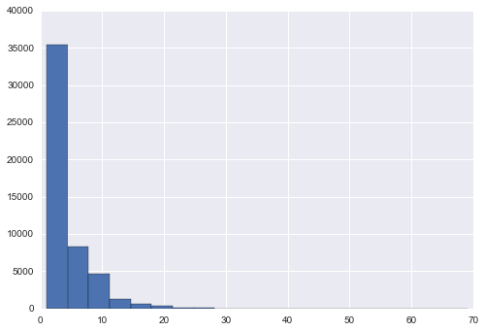
y: What’s the prediction (response)?
Predict a transformed count of hazards or pre-existing damages using a dataset of property information
50 discrete scores, ranging from 1 to 69
Ordinal labels
36% are no hazard, 1, and
75% < 5
rank ordering so focus on just getting them ordered right
99.9% < 30, so concentrate on those

Slide 5

How to make sense of these columns? Is there a direction to these?
No hazard (negative)
A lot of hazard (positive)
Hazard | T1_V8 | T1_V1 | T1_V2 | T2_V1 | T1_V15 | T1_V4
1 | B | 15 | 3 | 36 | A | N
1 | B | 7 | 17 | 64 | A | B
1 | B | 1 | 11 | 26 | N | C
1 | B | 17 | 4 | 71 | A | B
1 | B | 4 | 8 | 64 | A | N
Hazard | T1_V8 | T1_V1 | T1_V2 | T2_V1 | T1_V15 | T1_V4
51 | B | 18 | 20 | 40 | C | C
52 | C | 10 | 15 | 20 | A | N
63 | C | 19 | 7 | 15 | A | N
64 | C | 19 | 13 | 57 | A | W
69 | C | 13 | 20 | 50 | A | N

Slide 6
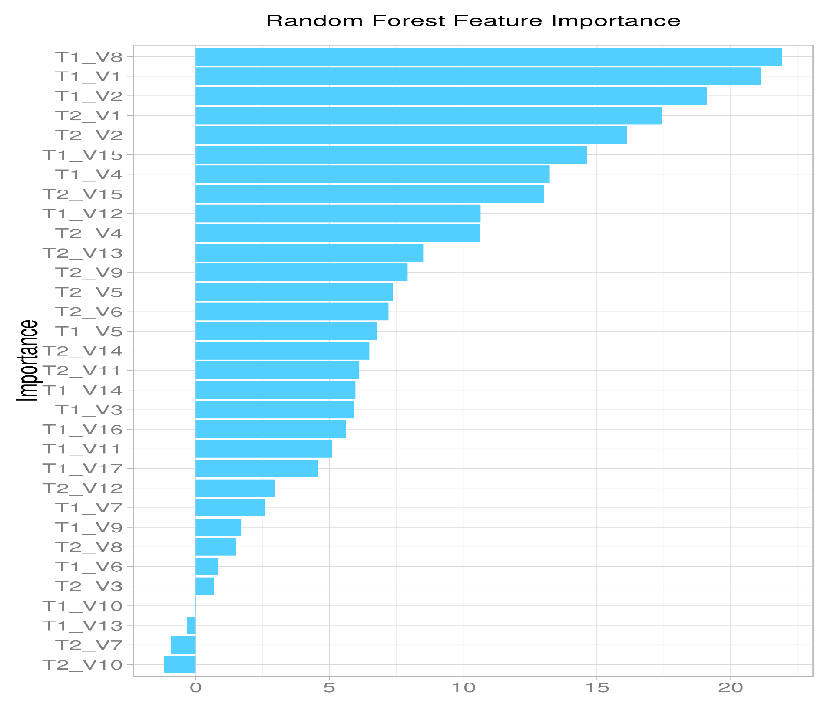

I don’t know the subject. Where do I start?
Run a classification and see which variables are the most important

Slide 7
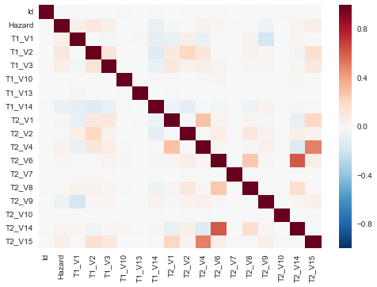
2. Combine collinear features
At least one collinearity among the numeric categories

Slide 8
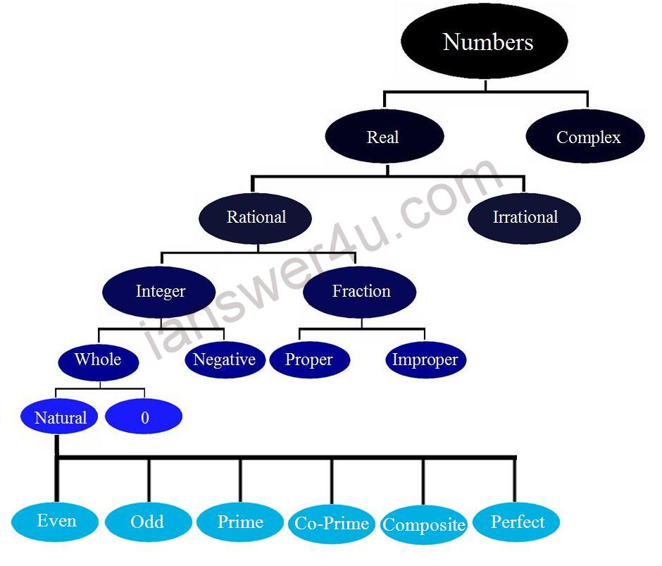
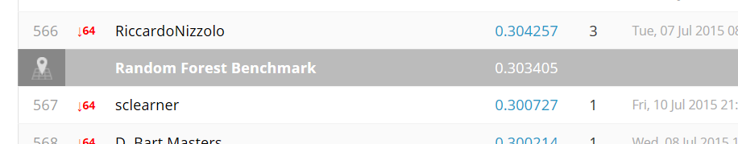
Regression, which model?
Linear regression models:
Linear Regression
GradientBoostingRegressor
Xtreme Gradient Booster
Random Forest is the benchmark, so start with that
ensemble.RandomForestRegressor(n_estimators=200, max_depth=9)

Slide 9

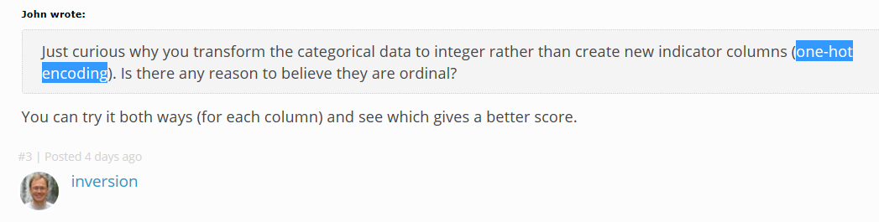
Strategy: encode character variables
Remove all characters and make them numbers?
Make dummy variables?
Use preprocessing.LabelEncoder()?
Use linear discriminant analysis to remove collinear categories?

Slide 10
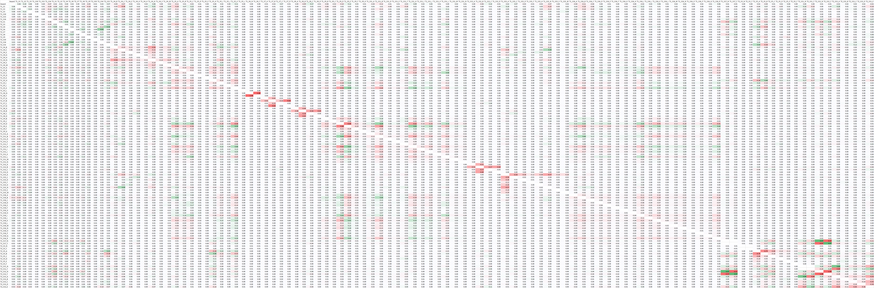
How to find the best variables?
Correlation is not obvious
Look by hand?
Exclude the largest hazards and stack a model for those?
Just build a linear model with the highest correlators
Build a linear model with the largest variables from Random Forest?

Slide 11
Scalars and Categorical Variables
Maybe some of categories are ordinal?

Slide 12
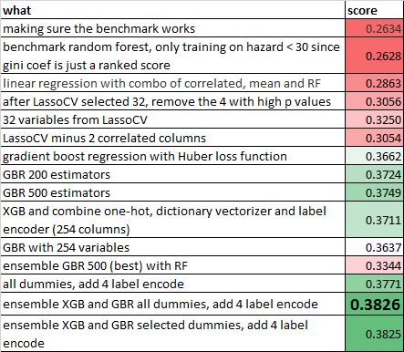
Kaggle History
674th out of 1822 top .3938 .0112 to go!

Slide 13
What is Gradient Boosting?
GB builds an additive model in a forward stage-wise fashion; it allows for the optimization of arbitrary differentiable loss functions. In each stage a regression tree is fit on the negative gradient of the given loss function.
loss function to be optimized. ‘ls’ refers to least squares regression. ‘lad’ (least absolute deviation) is a highly robust loss function solely based on order information of the input variables. ‘huber’ is a combination of the two.
Notes:
Unlike fitting a single large decision tree to the data, which amounts tofitting the data hardand potentially
overfitting, the boosting approach insteadlearns slowly.
By
fitting small trees to the residuals, we slowly improve ˆ
fin areas where it
does not perform well. The shrinkage parameterλslows the process down
even further, allowing more and different shaped trees to attack the residuals. In general, statistical learning approaches thatlearn slowly tend to
perform well. Note that in boosting, unlike in bagging, the construction of
each tree depends strongly on the trees that have already been grown.

Slide 14
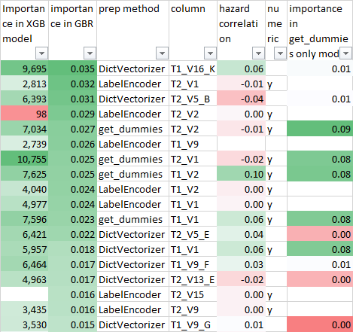
Using GBR to find important variables
Analyzed the variables’ importance
DictVectorizer same as get_dummies?

Slide 15
Are categorical variables ordinal?
If so, label encoder may generalize better

Slide 16
Next steps
Grid and tune the model
Ensemble
Find out what the top competitors are doing
Organize the code

Slide 17
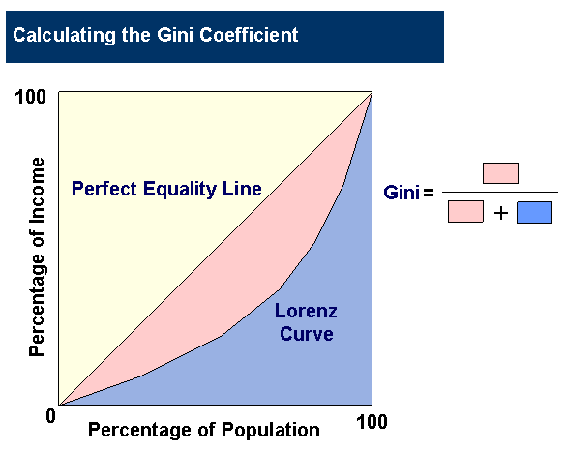
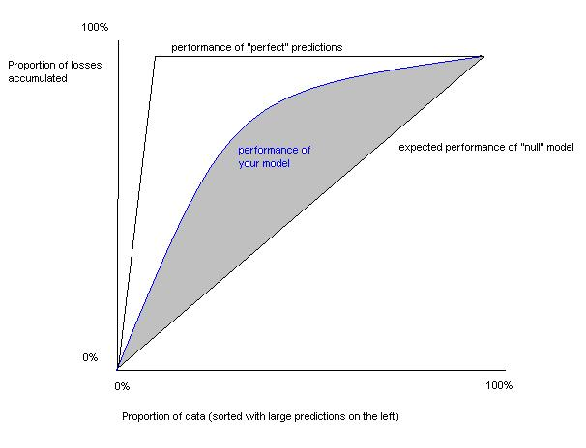
Model/contest evaluation
On a normalized Gini coefficient
The goal is essentially to build a model which predicts the correct order in terms of hazard.
The Gini Coefficient measures the area between your models Lorenz curve and that of a completely random submission.
The Gini coefficient can be used as a metric for determining how close your submission's order matches the actual one.
Rank ordering is scored, so maybe calibration is not as important?
Notes:
Gini coefficient closely related to the AUC (Area Under receiver operating characteristic Curve) measure of performance.^{[78]} The relation follows the formula
Kind of like AUC only for more than 2 classes
The normalized Gini is obtained by dividing the Gini coefficient of your model by the Gini coefficient of a perfect model.

Slide 18

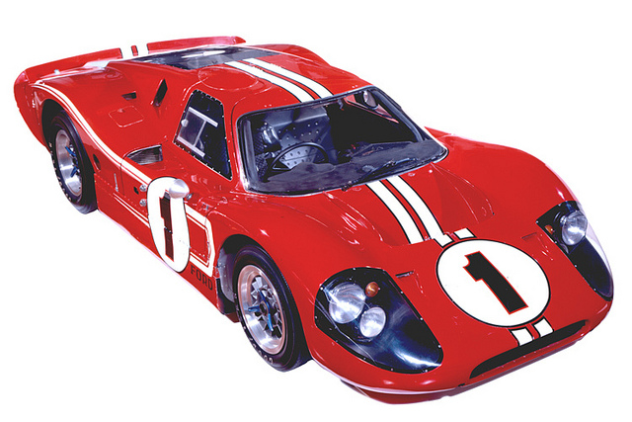
FTW, the
xgboost extreme Gradient Boosting (Tree) library, used by the top competitors on Kaggle
Ugh, have to build it first,
Wasn’t too bad.
51,000 and dummy variables may need extra processing if trying to do LOOCV
Amazon, rent a server?

Slide 19
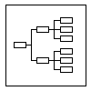
Solution organization
Explore.py
Preprocess.py
Model.py
Score.py

